Slide 1
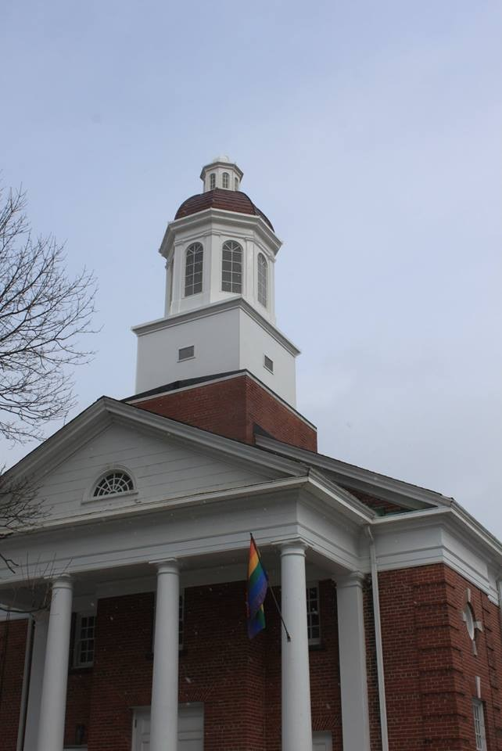
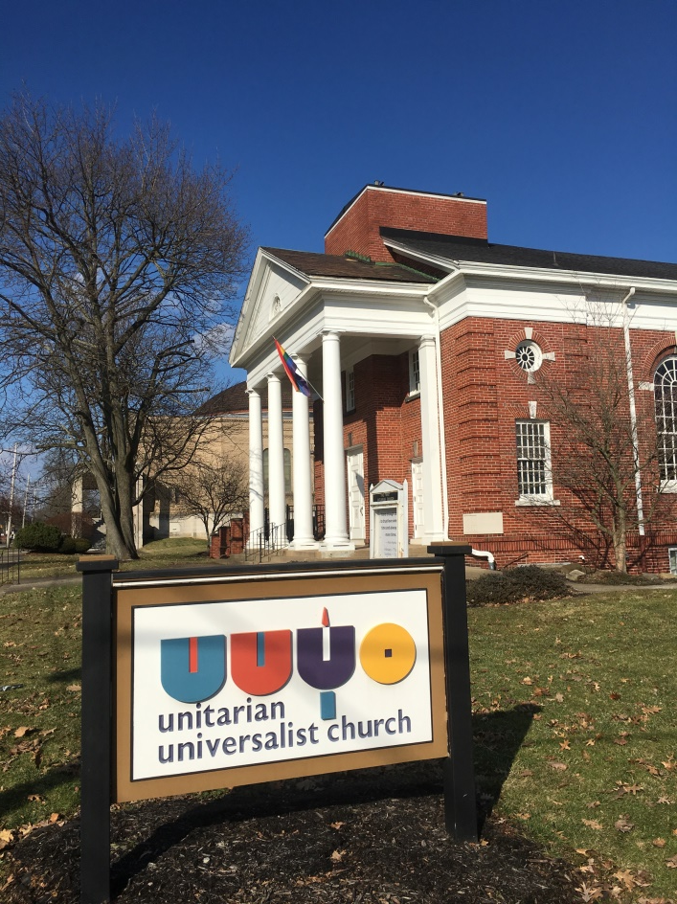
A Peak at UUYO
1925 | 2013 | 2019

Slide 2
Our cupola arrived in three parts
The cupola was transported by truck from the manufacturing site in Texas and arrived at 1105 Elm Street Monday morning, February 17, 2019 a little before 8 am.
The trip from Texas was eventful. When the driver reached Indiana the winds were so strong that he delayed the trip across Indiana to Ohio for fear of damaging the cupola. He had to get a new transport permit to continue the trip, but thought the better course of action was to delay the transport until wind conditions improved.
He made it! All in the same three pieces as when he left Texas.

Slide 3
One Happy Driver!

Slide 4
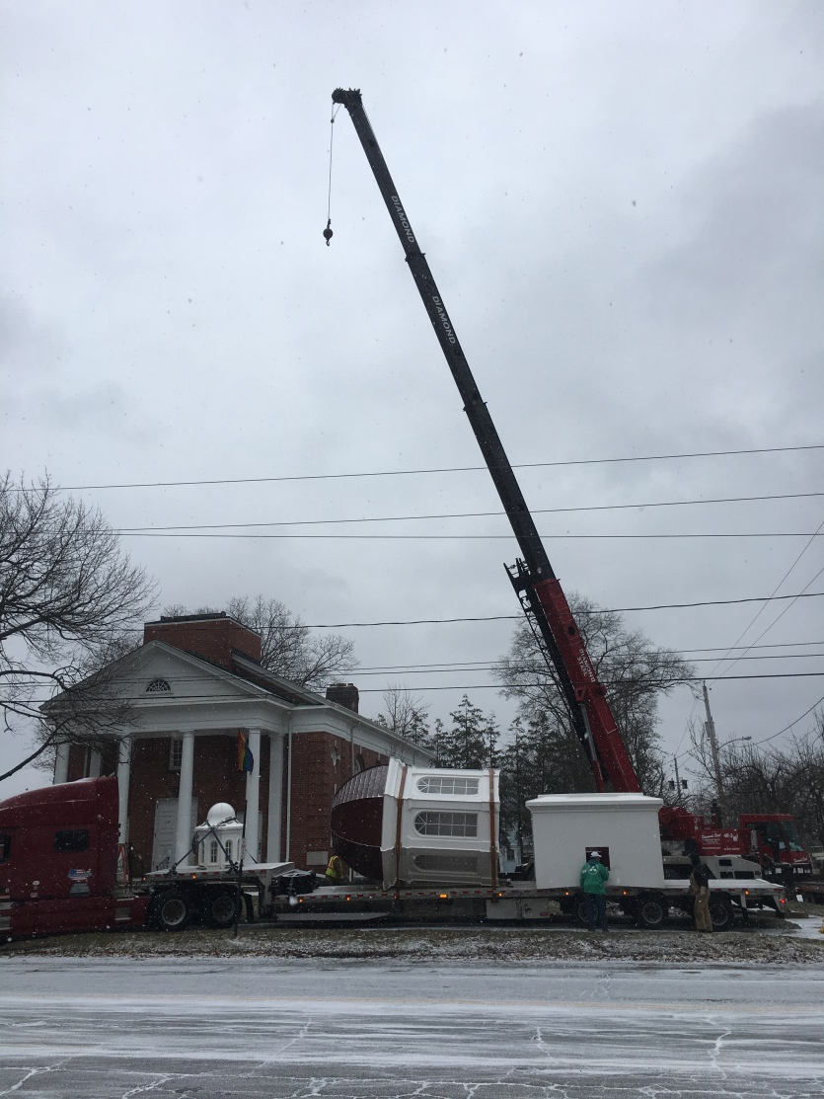
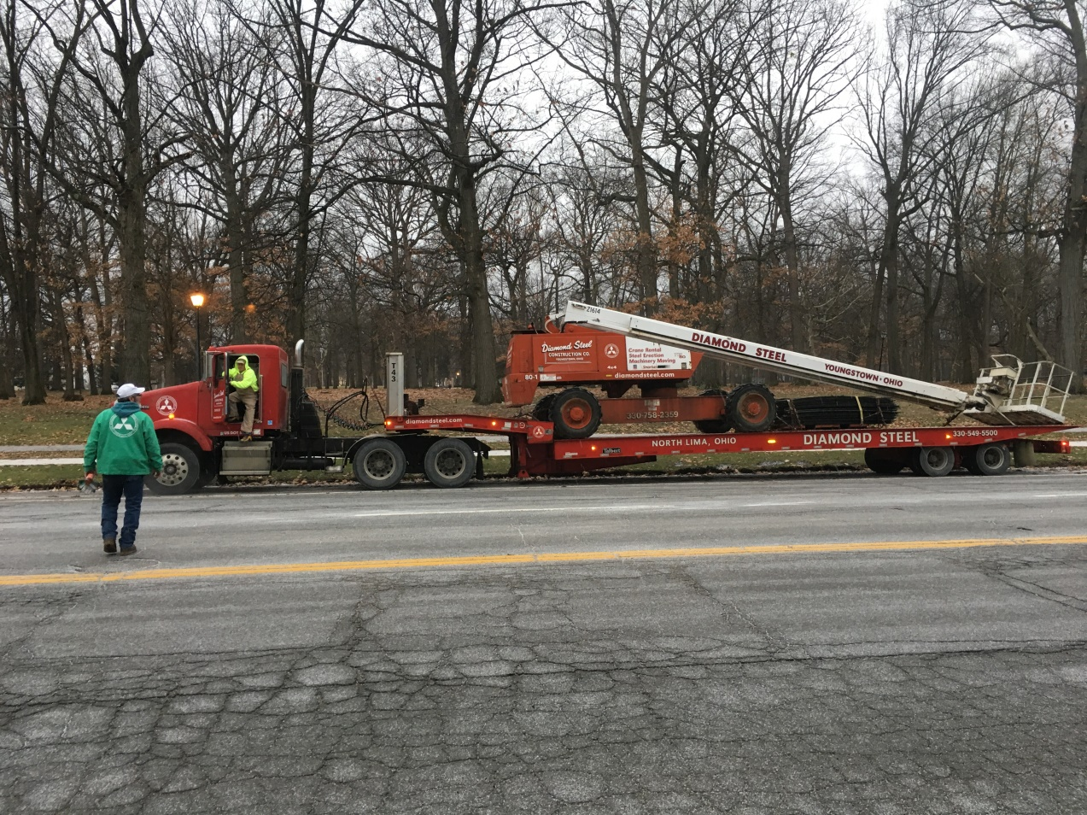
The cranes are here

Slide 5
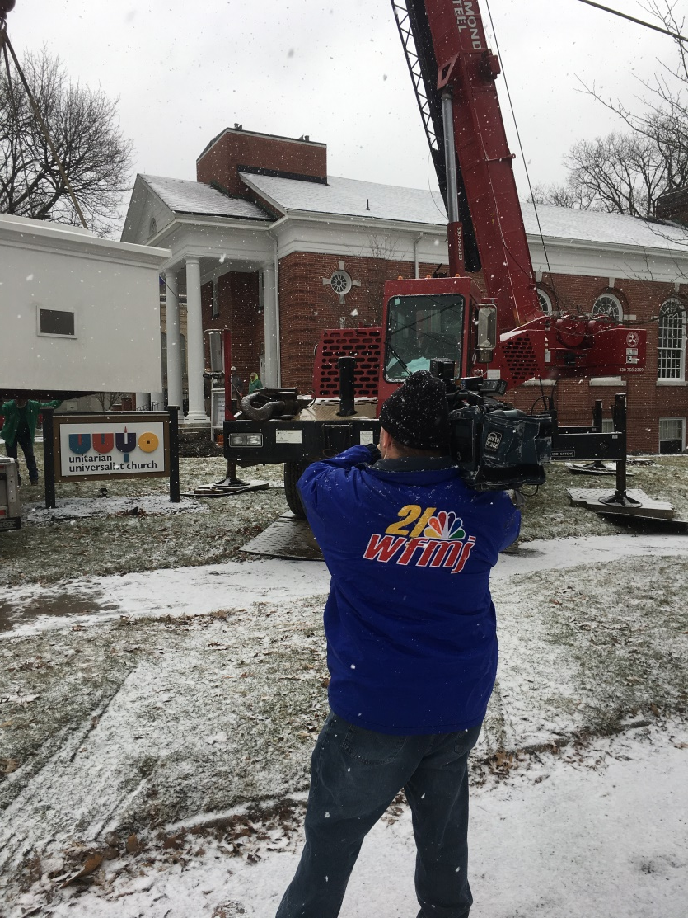
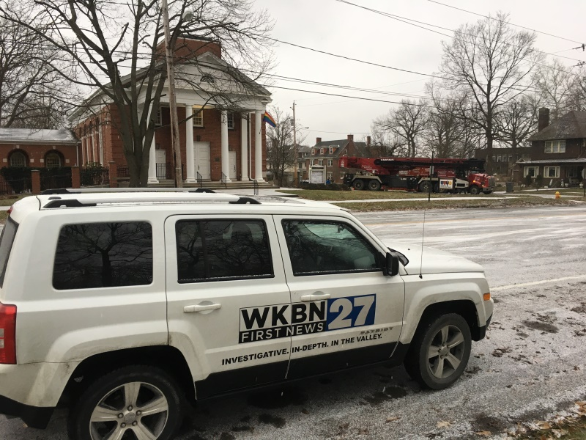
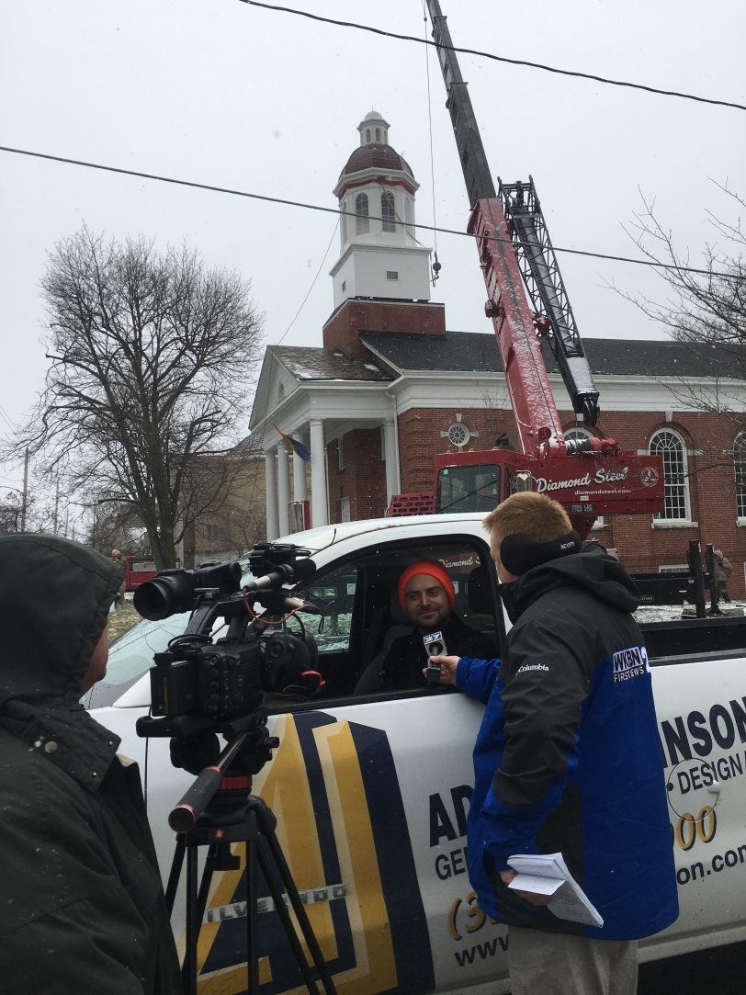
…and the media

Slide 6
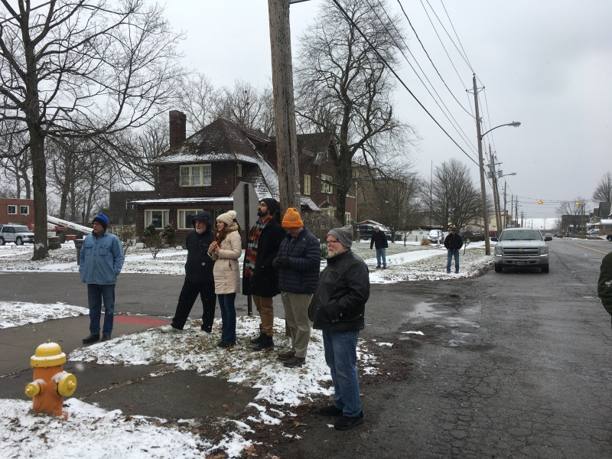
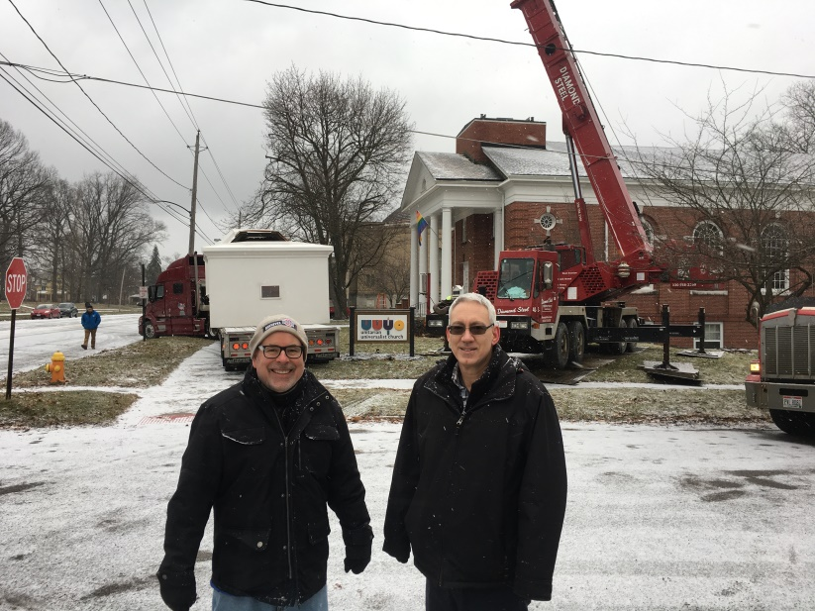
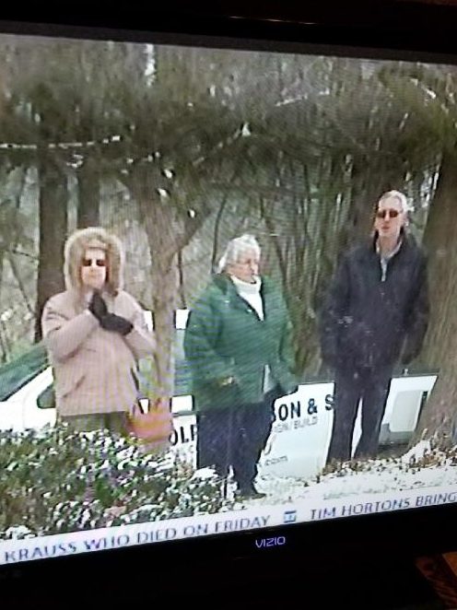
…not to mention UUYO members

Slide 7
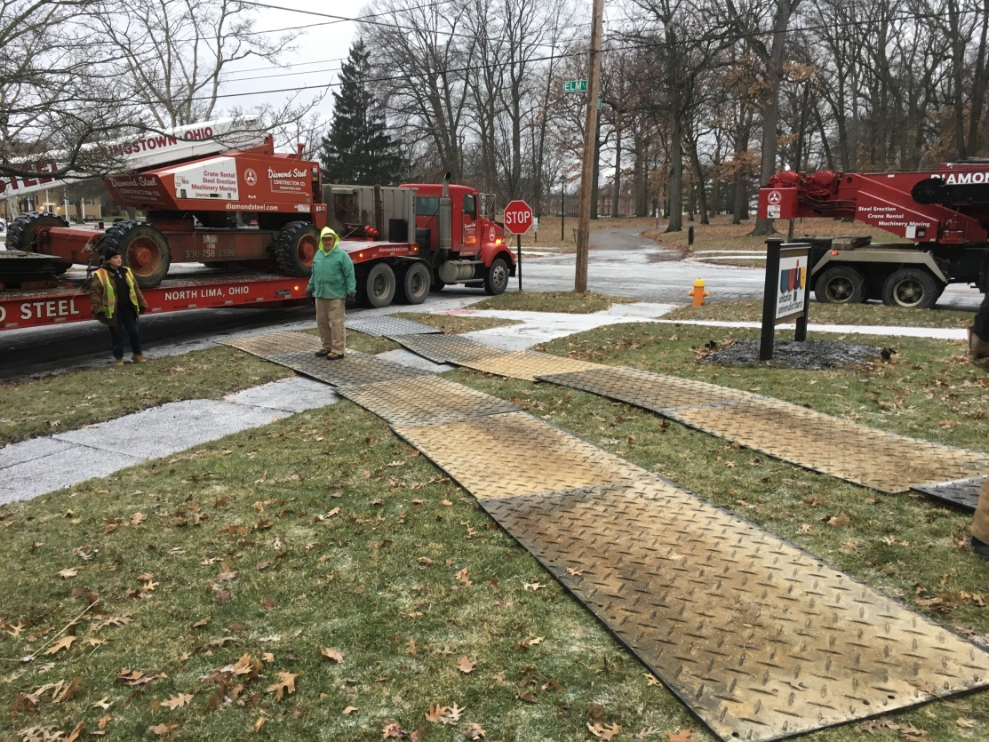
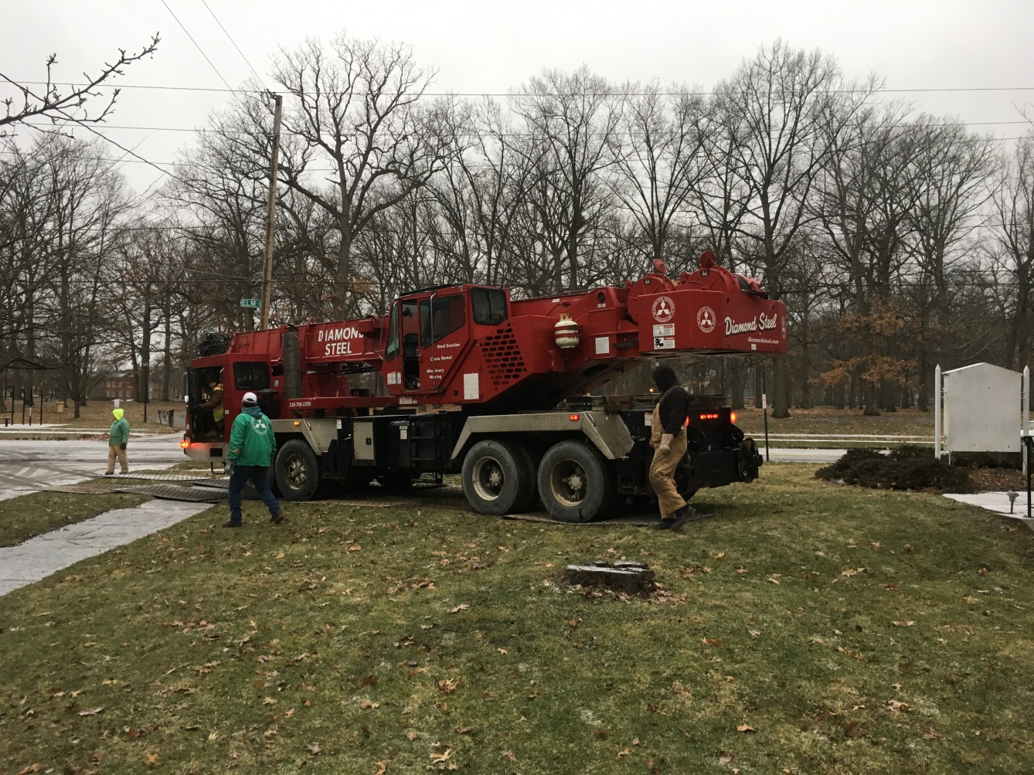
We must protect the lawn

Slide 8
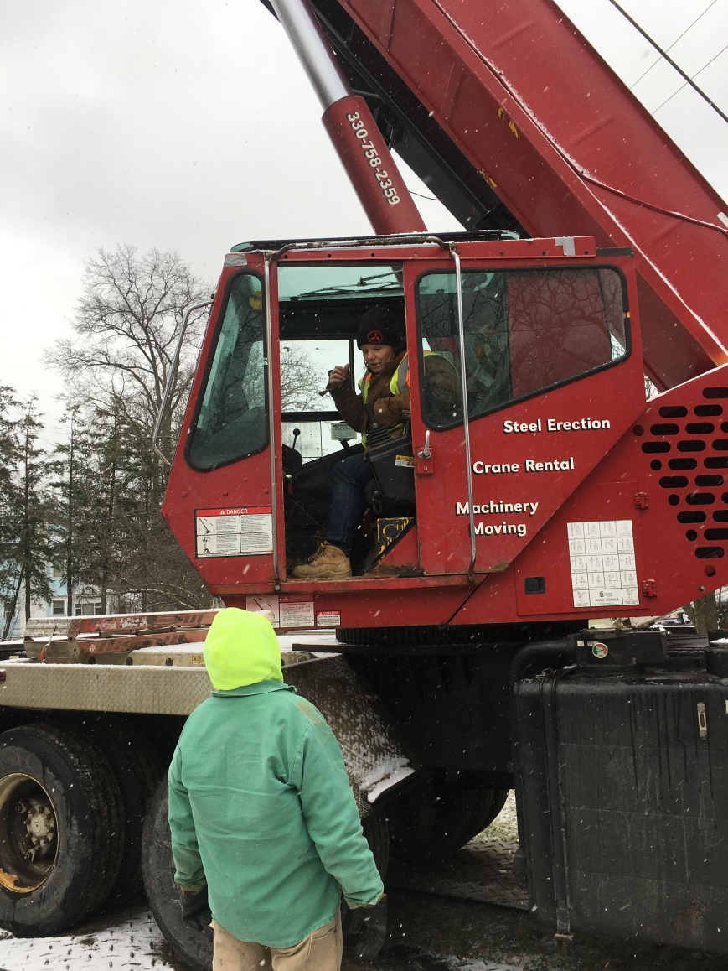
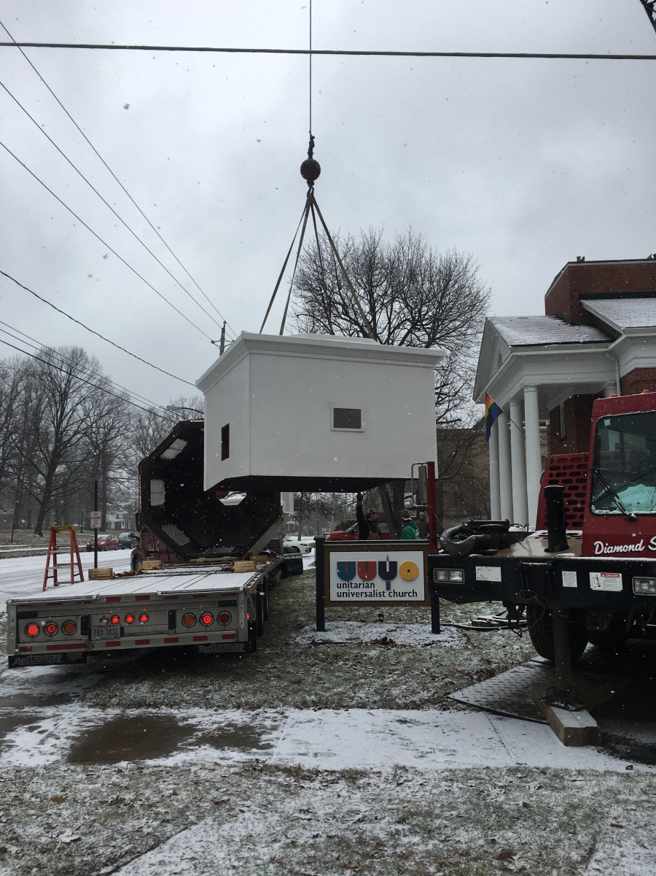
Let’s get this party started - lifting the base

Slide 9
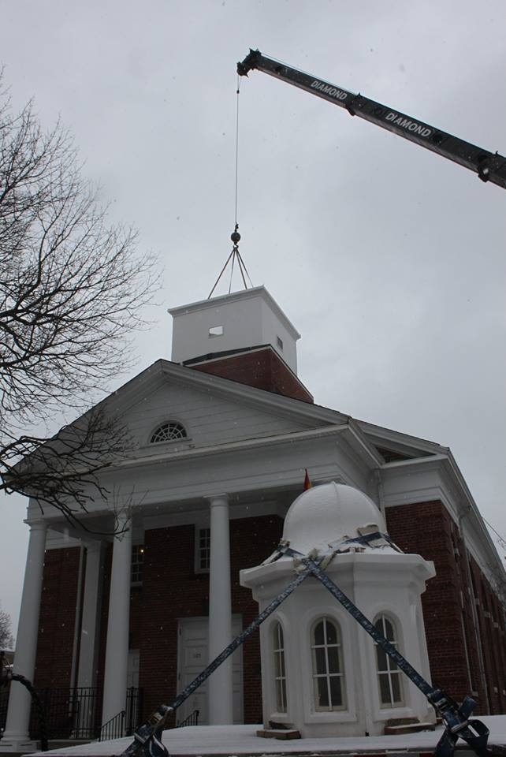
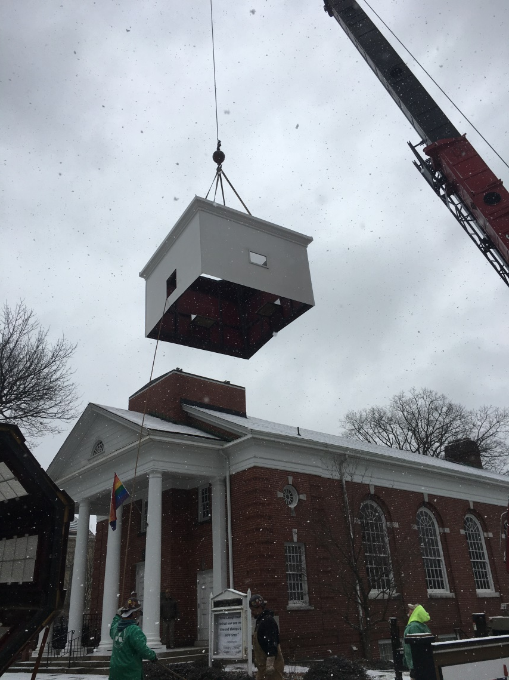
The base is set

Slide 10
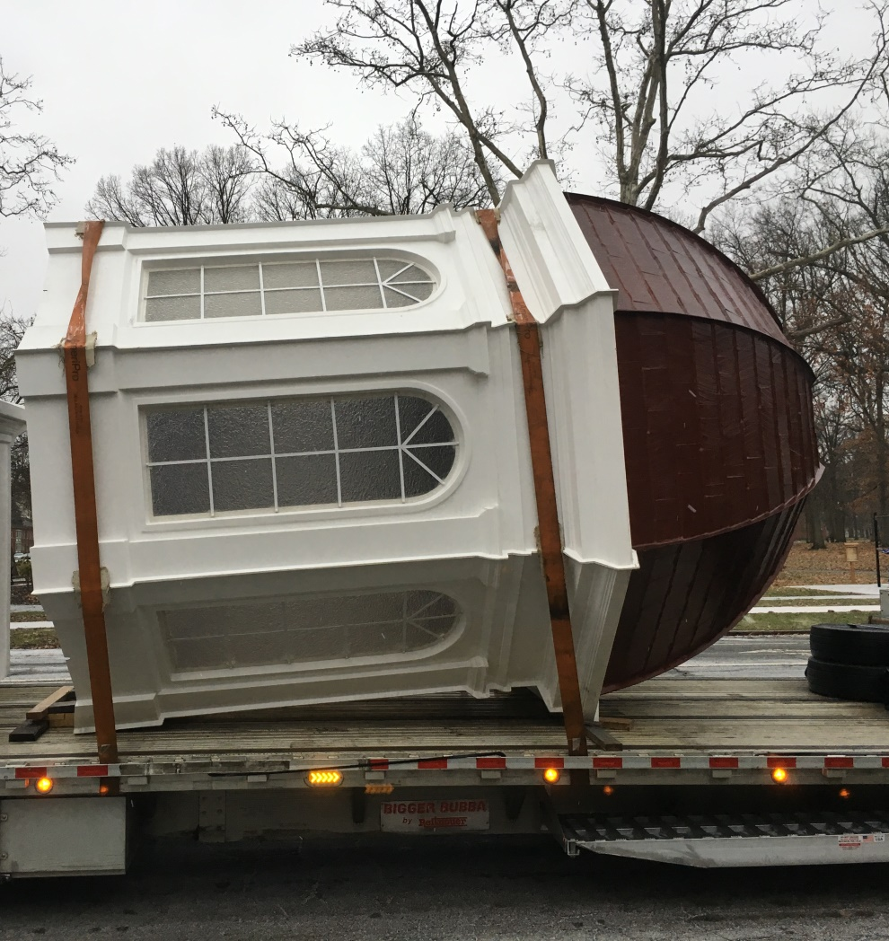
Cupola body parts

Slide 11
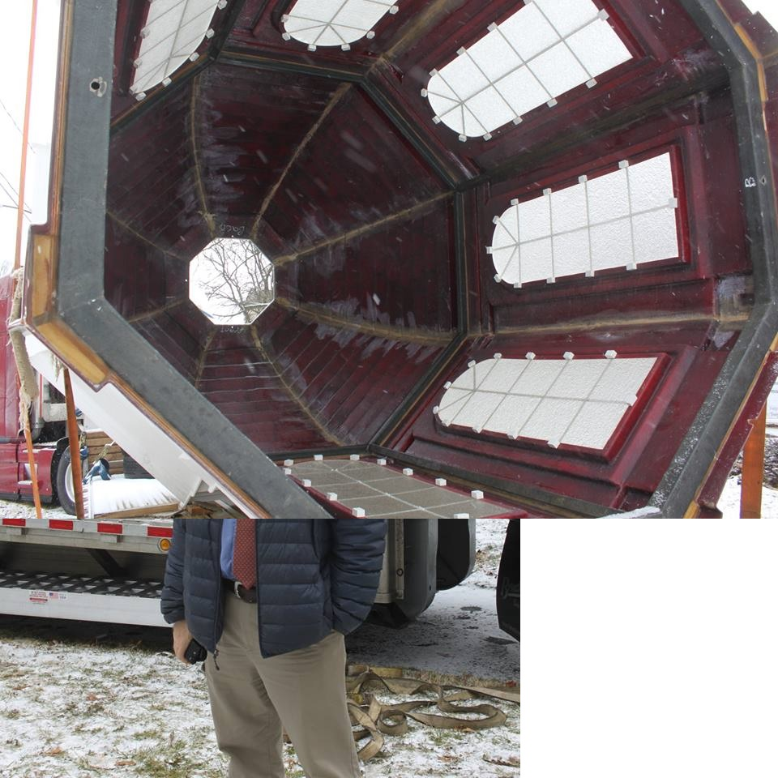
A view from below

Slide 12
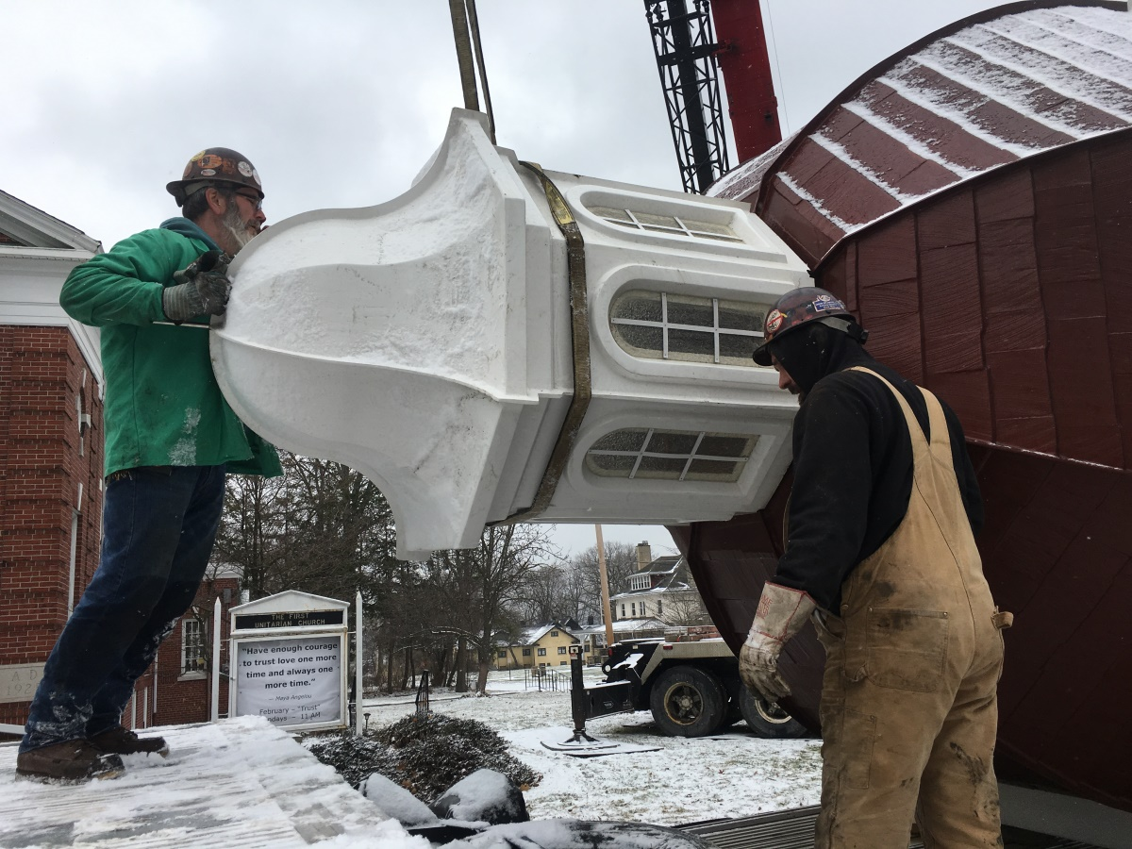
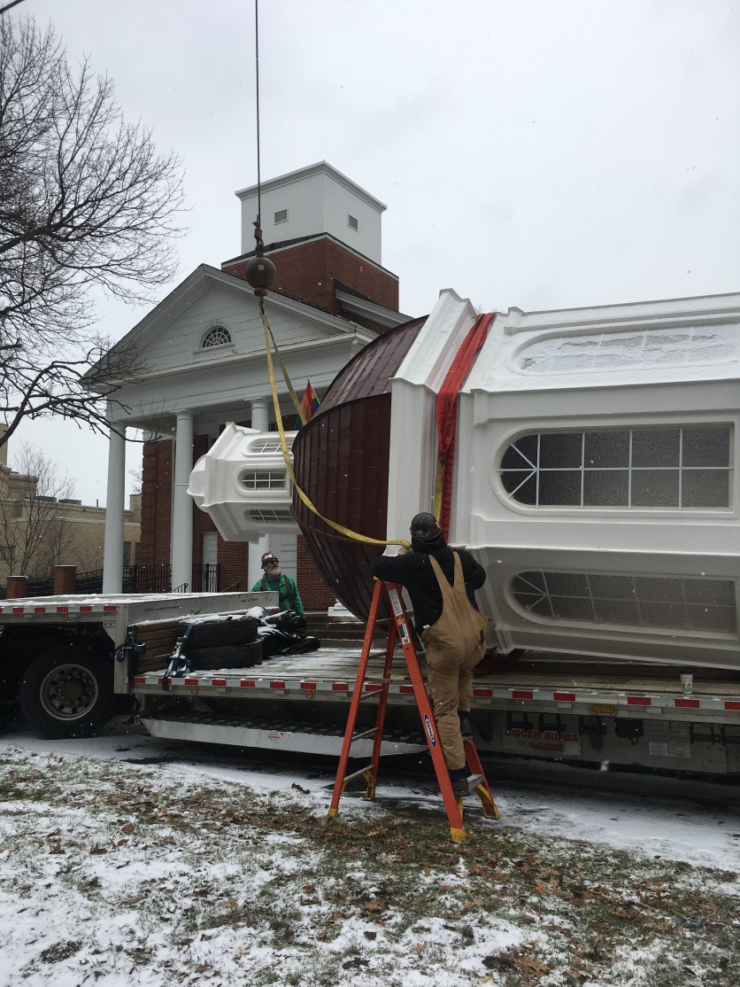
Ready to move body off the truck

Slide 13
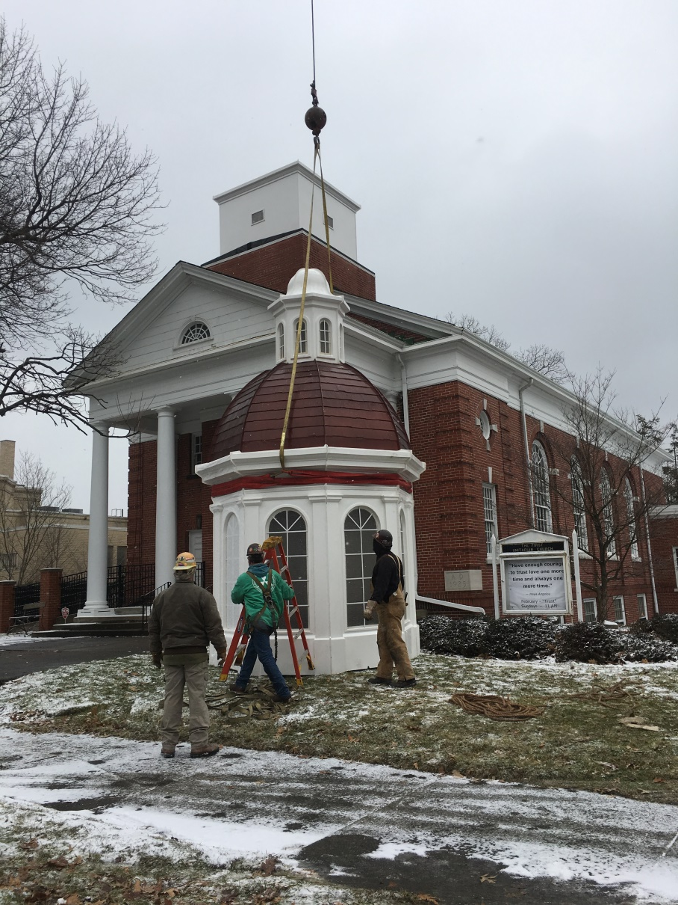
All together and off the truck!

Slide 14
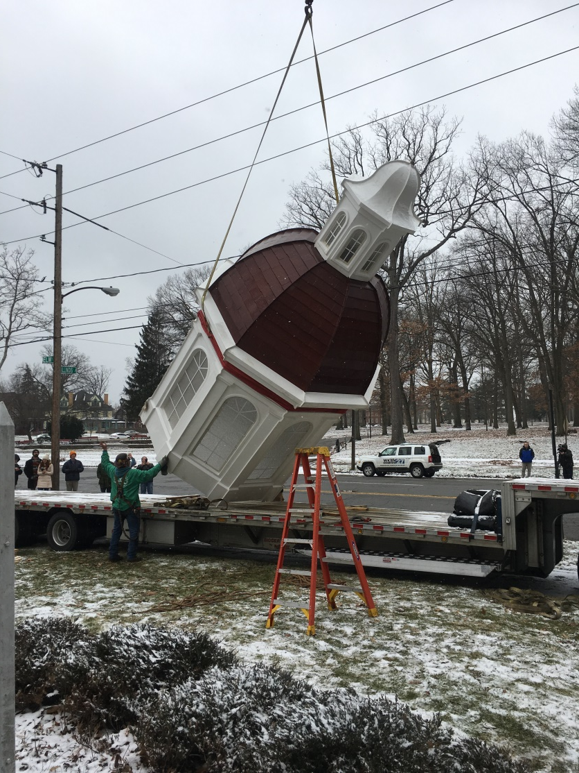
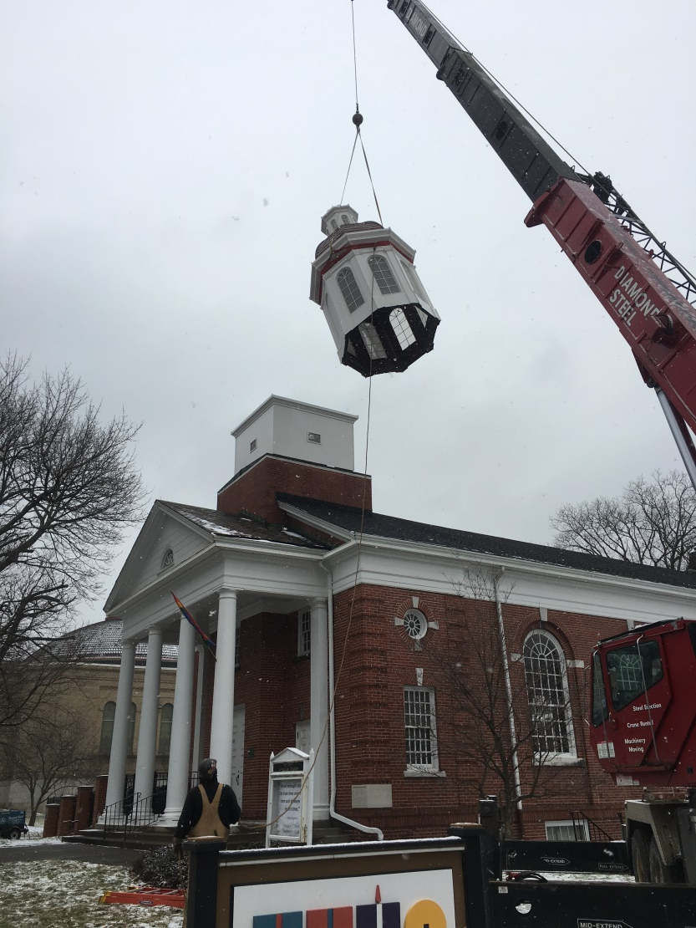
Liftoff and flying

Slide 15
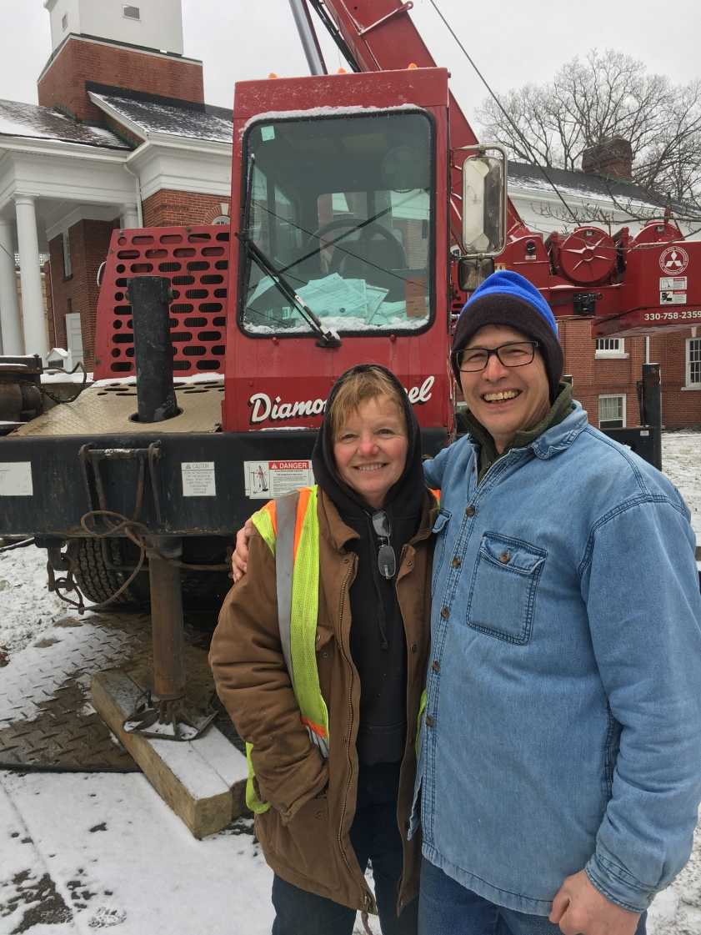
She did it!

Slide 16
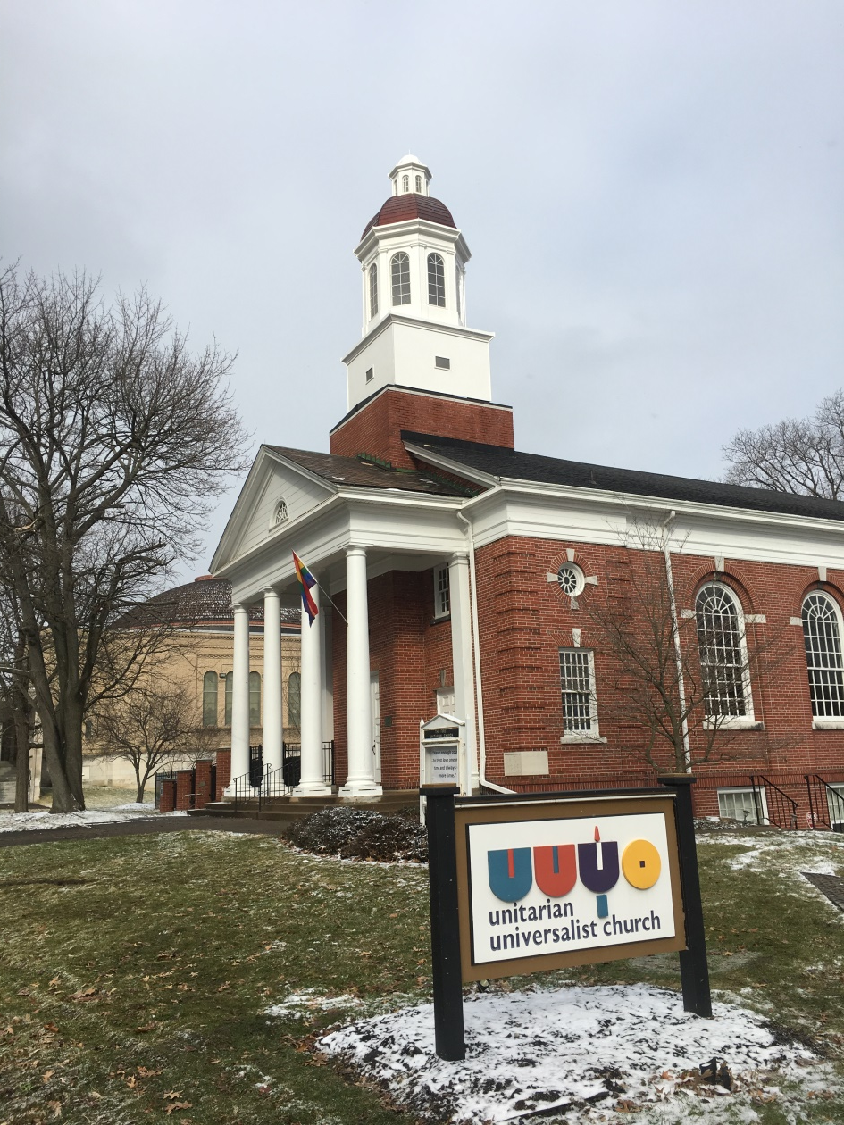
Cupola Installed!

